Slide 1

FitGeek: Modelling ML Based Recommendation System for fitness and wellness
Shreya Mahajan 20104001
Saniya Dutta 20104041
Anish Bhosale 20104033
Project Guide
Prof. Randeep Kaur Kahlon

Slide 2
Contents
Abstract
Introduction
Objectives
Literature Review
Problem Definition
Scope
Technology Stack
Proposed System Architecture/Working
Prototype Design Demonstration
References

Slide 3
1. Abstract
The FitGeek transcends the boundaries of a mere fitness website; it represents a transformative and comprehensive wellness platform meticulously crafted to empower individuals on their journey to take full control of their health and fitness.
Personalized Wellness Solutions: Our platform offers personalized solutions that cater to your unique needs, preferences, and objectives.
Guidance Every Step of the Way: Fitgeek provides you with the guidance you need, ensuring that every step you take aligns with your specific goals
Continuous Learning and Growth: Fitgeek is committed to keeping you informed and up-to-date with the latest trends, research, and best practices in the wellness industry.
FitGeek isn't just a destination; it's a way of life. It's about embracing the full spectrum of your well-being, taking charge of your health, and ultimately leading a life that's not just healthier but also happier.

Slide 4
2. Introduction
FitGeek represents a new era in wellness, driven by our vision to make health and fitness universally achievable.
FitGeek simplifies the wellness journey, offering science-based solutions, personalized plans, and a dash of fun.
FitGeek's personalized fitness plans, powered by cutting-edge technology, cater to individual preferences and goals.
FitGeek’s vibrant community of fitness enthusiasts and experts provides motivation and shared experiences.
FitGeek has an ever-expanding library of educational content, we empower users to make informed health and fitness choices.
FitGeek is a lifelong commitment to your well-being, making fitness an attainable and enjoyable journey for all.

Slide 5
3. Objectives:
To Provide Convenient and Economical Fitness Guidance: To offer affordable and easily accessible fitness guidance.
To Offer Instructional Exercises with Animations: To provide exercises with clear instructions, animated demonstrations and on a timer.
To Raise Awareness About Healthcare Updates: To inform and raise awareness about recent healthcare updates.
To Enable Remote Access to Exercises and hydration calculator: To facilitate remote access to exercises via web.
To Implement Disease Predictors: To include disease predictors for conditions like diabetes and stress, along with relevant recommendations.
To Offer Personalised Diet Recommendations: To provide tailored diet recommendations based on the person’s body statistics.
To calculate stress levels of the user: To create a tab where the user can get access to various mental health practices.

Slide 6
4. Literature Review:
YEAR | AUTHOR | TITLE | OUTCOME | DRAWBACK
2022 | Ajitesh Sharma; Yatin Pandey | Design and implementation of fitness management website | Member will have various attractive features on website like online music for the workout, online payment, also a noteworthy questionnaire having feature with the assistance of AI. | Developing a fitness SPA is a complex and expensive task with potential security and scalability issues, as well as business challenges such as competition, marketing, and customer support.
2022 | Chi Zhang; Xiaoli Hu | Prediction of New Media Communication of Fitness Culture and Its Influence Factors | Factors influencing fitness video communication on Bilibili include theme, subtitles, duration, fan base, uploader gender, and nationality. | Fitness videos on Bilibili with weight loss themes and videos with subtitles have lower communication effectiveness
2020 | Parinaz Bulky | A multipurpose sensor based system for weight training | Device monitors weight and user activities by using IMU using algo of LDA and SVM | Requires external hardware devices
2020 | Ching-Ting Hsu | Implementation of IoT Device on Public Fitness Equipment for Health Physical Fitness Improvement | IoT architecture for public fitness equipment improves physical fitness by providing efficient exercise and personalized prescriptions. | IoT architecture for public fitness equipment may be expensive to install and maintain and require technical knowledge to use effectively..
2017 | Dipankar Das; Shiva Murthy Busetty | Strength Training: A Fitness Application for Indoor Based Exercise Recognition and Comfort Analysis | Automatic indoor exercise recognition and comfort analysis system with 95.3% accuracy for activity recognition and 99.4% accuracy for repetition count. | Automatic indoor exercise recognition and comfort analysis system may be expensive, require wearable devices, and have accuracy issues depending on the quality of the devices and the user's technique

Slide 7
5. Problem Definition:
Problem Definition:
Widespread reliance on irrelevant or inaccurate fitness information and incorrect workout plans found on the internet.
This dependence on internet sources can lead to serious injuries or ineffective workouts that do not suit individual body types.
Access to proper fitness guidance is economically unfeasible for many individuals.
Proposed Solution:
FitGeek aims to empower fitness enthusiasts with knowledge to approach their fitness goals more effectively and safely.
Users can target specific muscle groups for their workouts and learn the corresponding exercises through interactive animations.
FitGeek bridges the gap between unreliable fitness information and economic constraints, making fitness accessible and personalized for all.

Slide 8
6. Scope:
Enhanced Fitness Progress: AI-powered recommendations adapt as users progress, ensuring optimal workout plans.
Calorie Intake Tracker and Analysis: Implement algorithms for analysing calorie intake against individual goals and dietary preferences.
Personalized Diet Plans: Incorporate nutritional analysis to ensure users receive balanced and tailored dietary recommendations.
Hydration Calculator: Develop a hydration calculator that calculates daily water intake needs based on user profiles, activity levels, and environmental conditions.
Stress Level Assessment: Implement stress assessment tools, such as surveys or wearable device integrations, to measure users' stress levels.
Mental Health Practices: Integrate mental health practices, including mindfulness and meditation exercises and offer guided sessions and resources to improve mental well-being.
User Engagement and Tracking: Implement tracking features to monitor users' adherence to recommendations and progress towards wellness goals.
Email Validation: Users will have to validate their email ids for authorization and validating the individuality while sign in,

Slide 9
7. Technology Stack:
Frontend : WEB X.O
1. HTML : for structure
2. CSS : for styling
3. JavaScript : for interactive elements
4. Bootstrap : CSS framework for responsive and attractive designs
Backend:
1. Django : framework for web application development
2. Python : for backend logic
Libraries: DATA ANALYSIS
1. Pandas
2. Numpy
3. Matplotlib

Slide 10
For ML related features:
1. Scikit-learn : for building disease prediction models.
2. TensorFlow or PyTorch : For building recommendation and machine learning models.
5. Streamlit : for Machine Learning models.
ML Algorithms:
K-Nearest Neighbors: for classification and regression tasks of the diet recommender.
Support Vector Machine: for classifying individuals into one of two classes: diabetic or
non-diabetic, in the diabetes predictor.
Content-Based Filtering: for exercise recommendation system based on the Bmi category of the user.
Natural Language Processing: to determine the stress levels of the user based on the inputs provided.
Logistic Regression: to predict stress levels categorised into different classes (e.g., low, moderate, high).

Slide 11
Review 1 Suggestions
Email Verification
Presentation changes (Literature Review in table, Recent year papers, Introduction in points)
Gmail signup
Exercise dataset

Slide 12
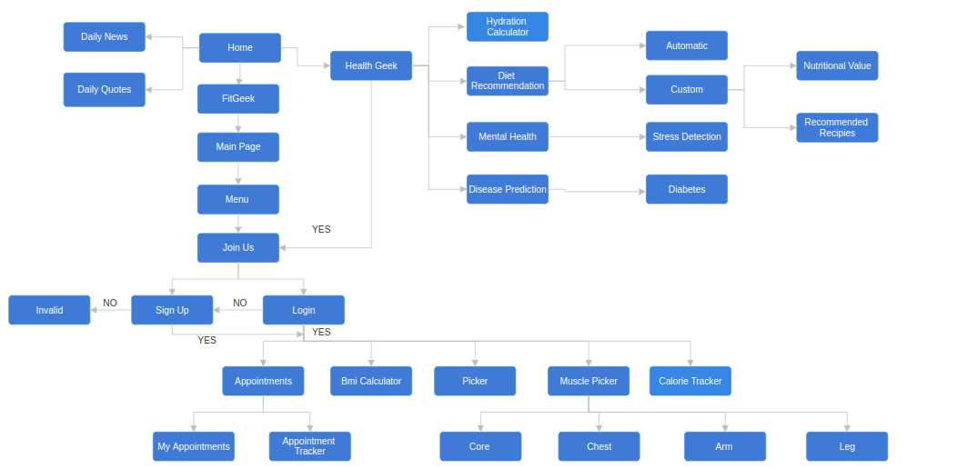
8. Proposed System Architecture/Working:
-

Slide 13
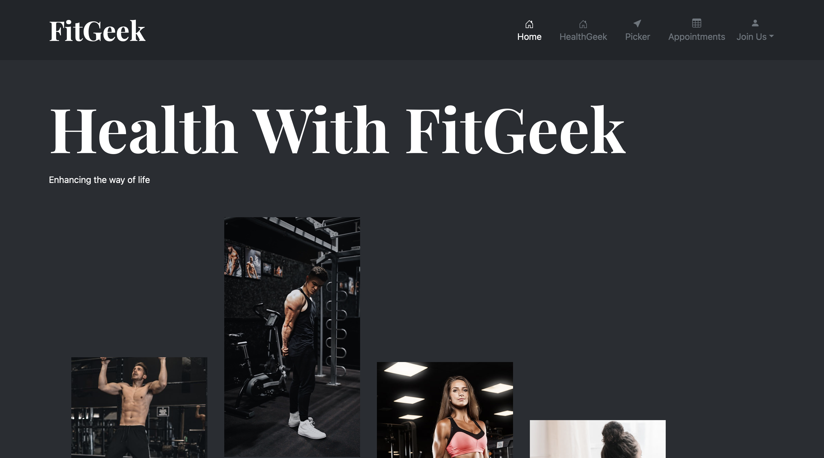
9. Prototype Design Demonstration:

Slide 14
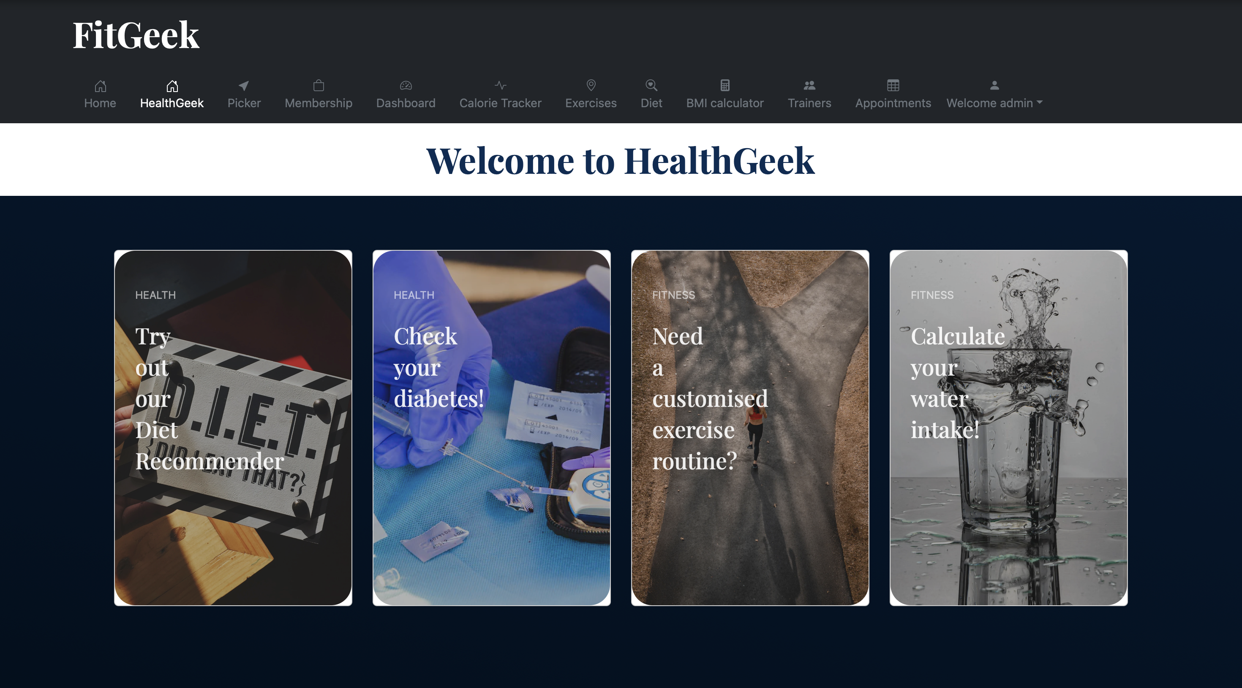

Slide 15
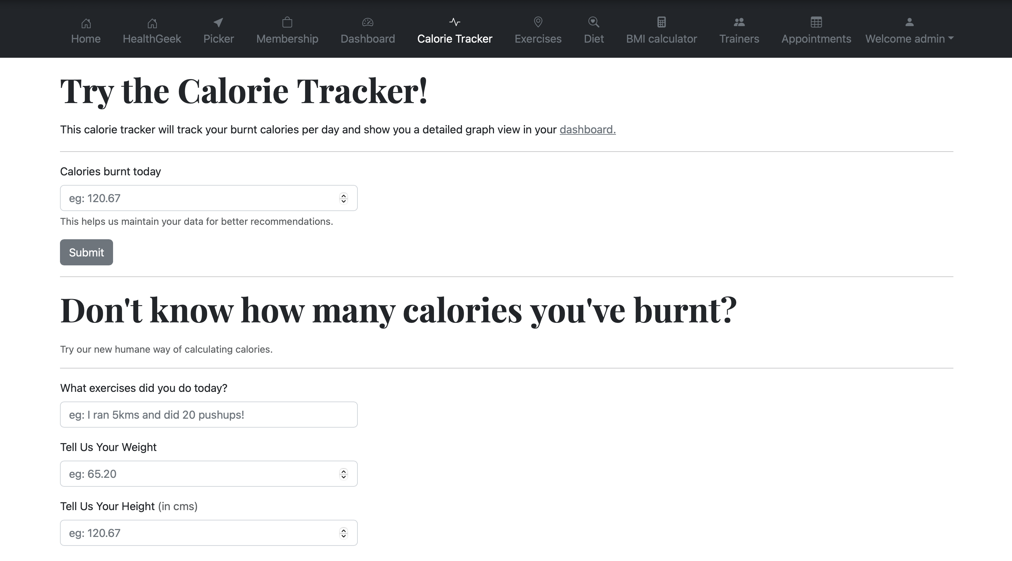

Slide 16
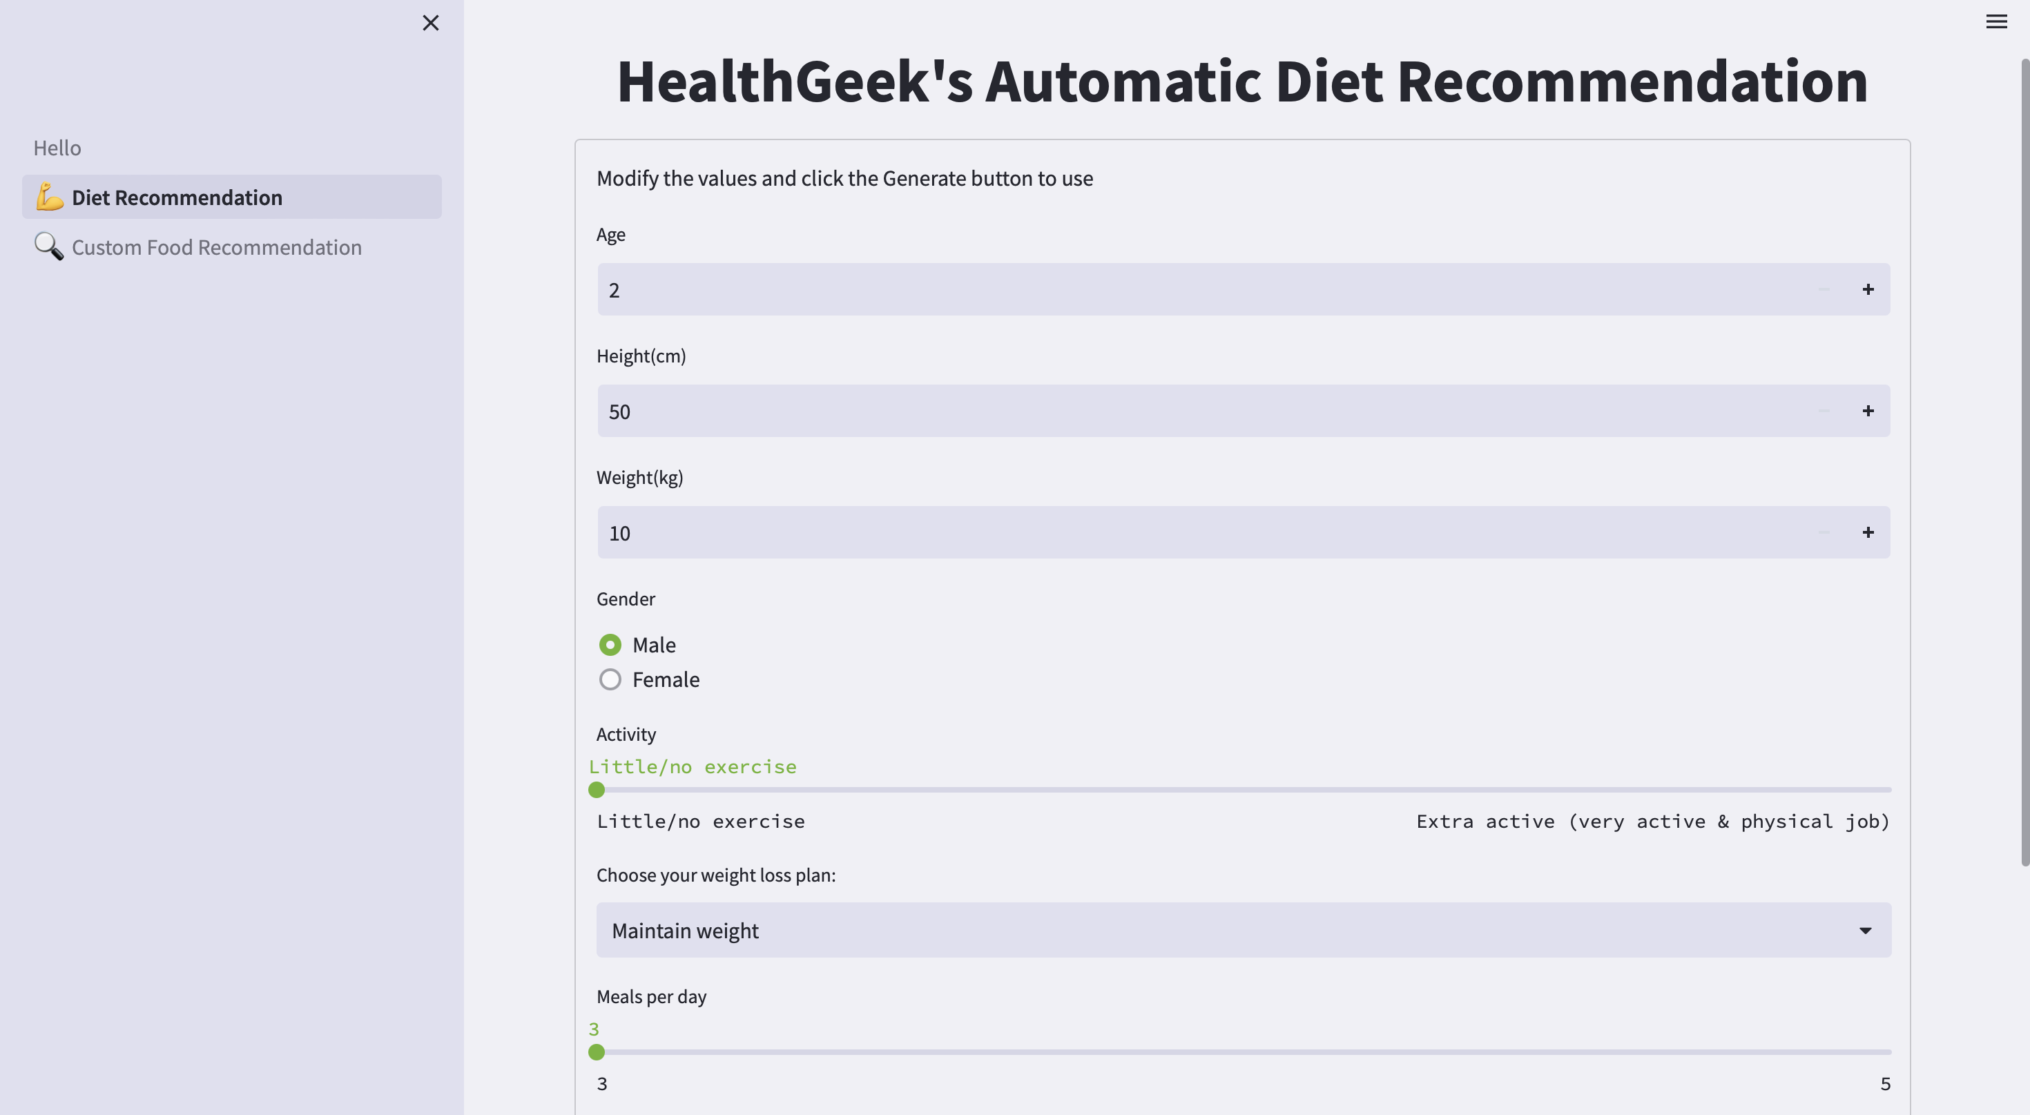

Slide 17
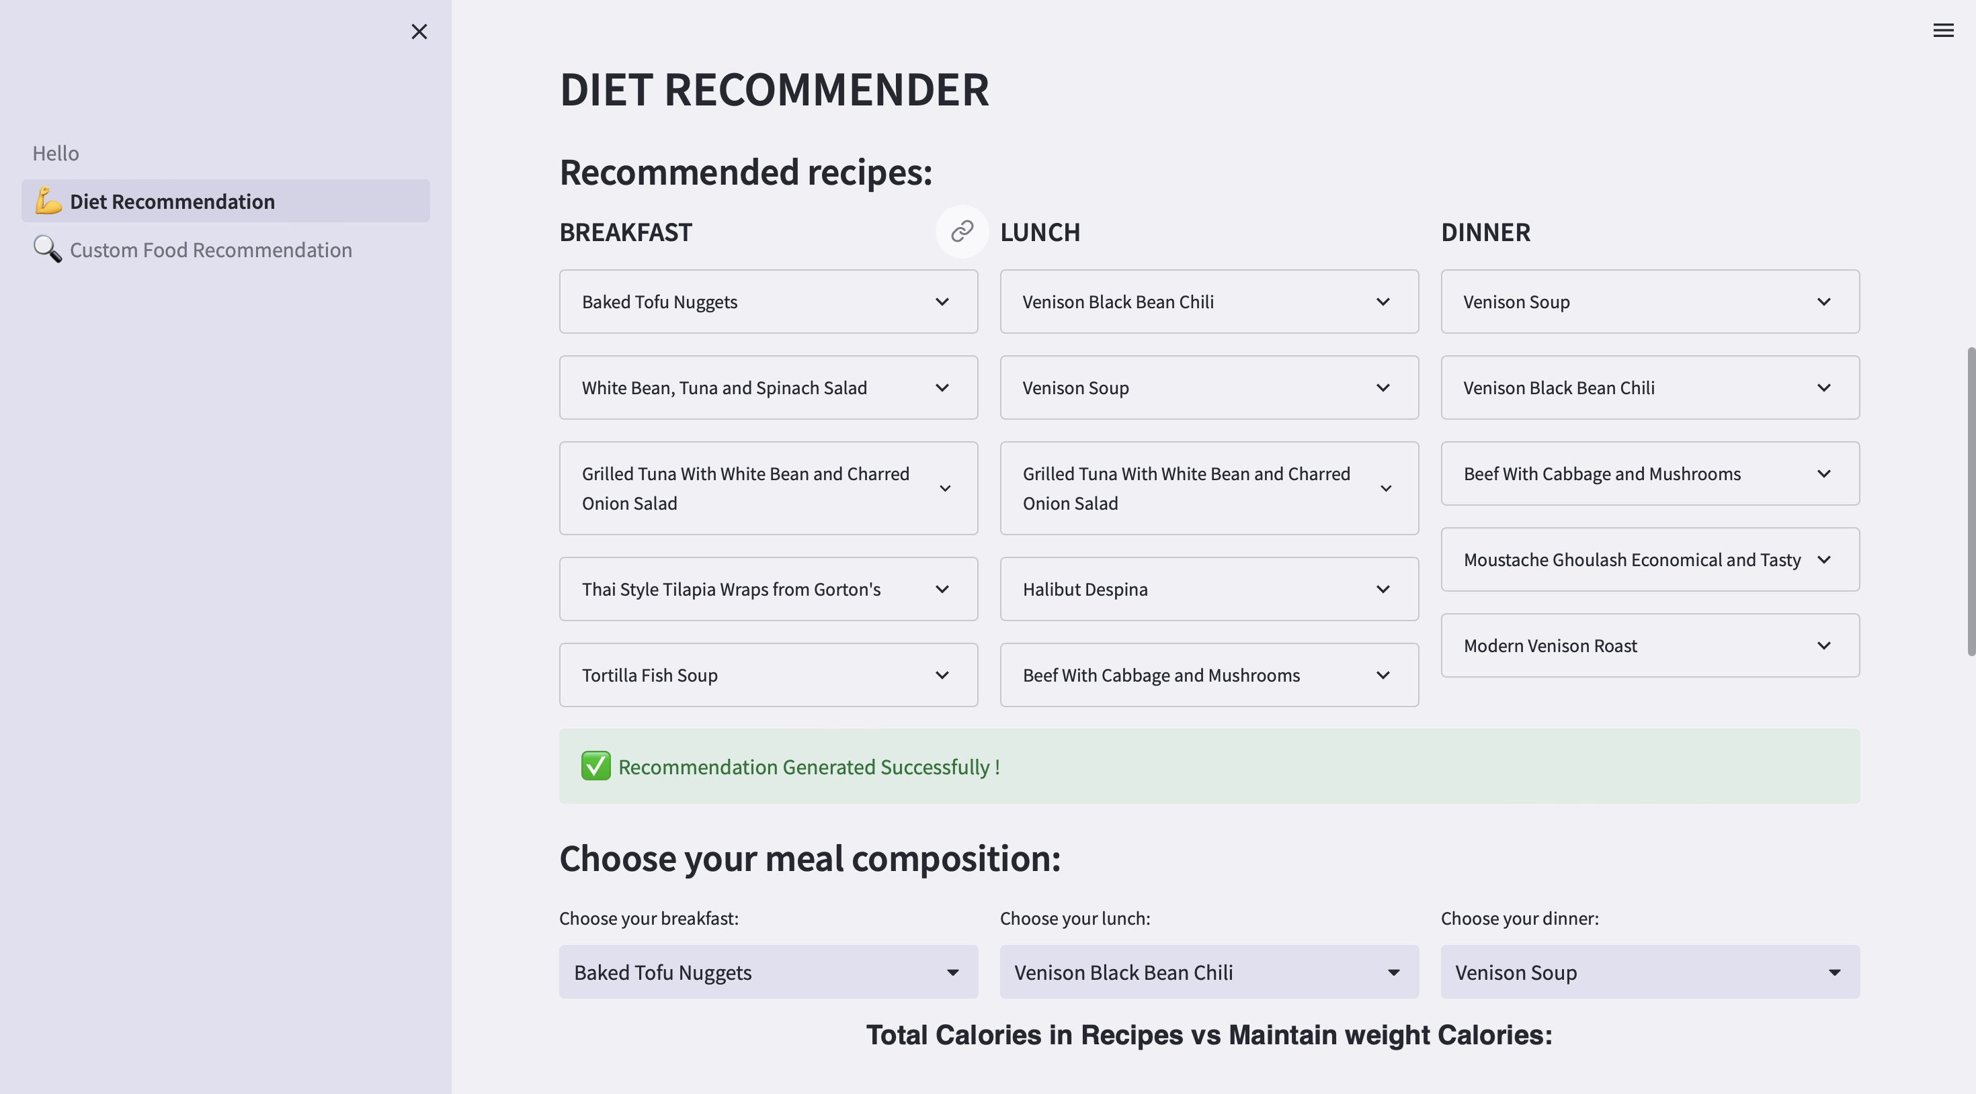

Slide 18
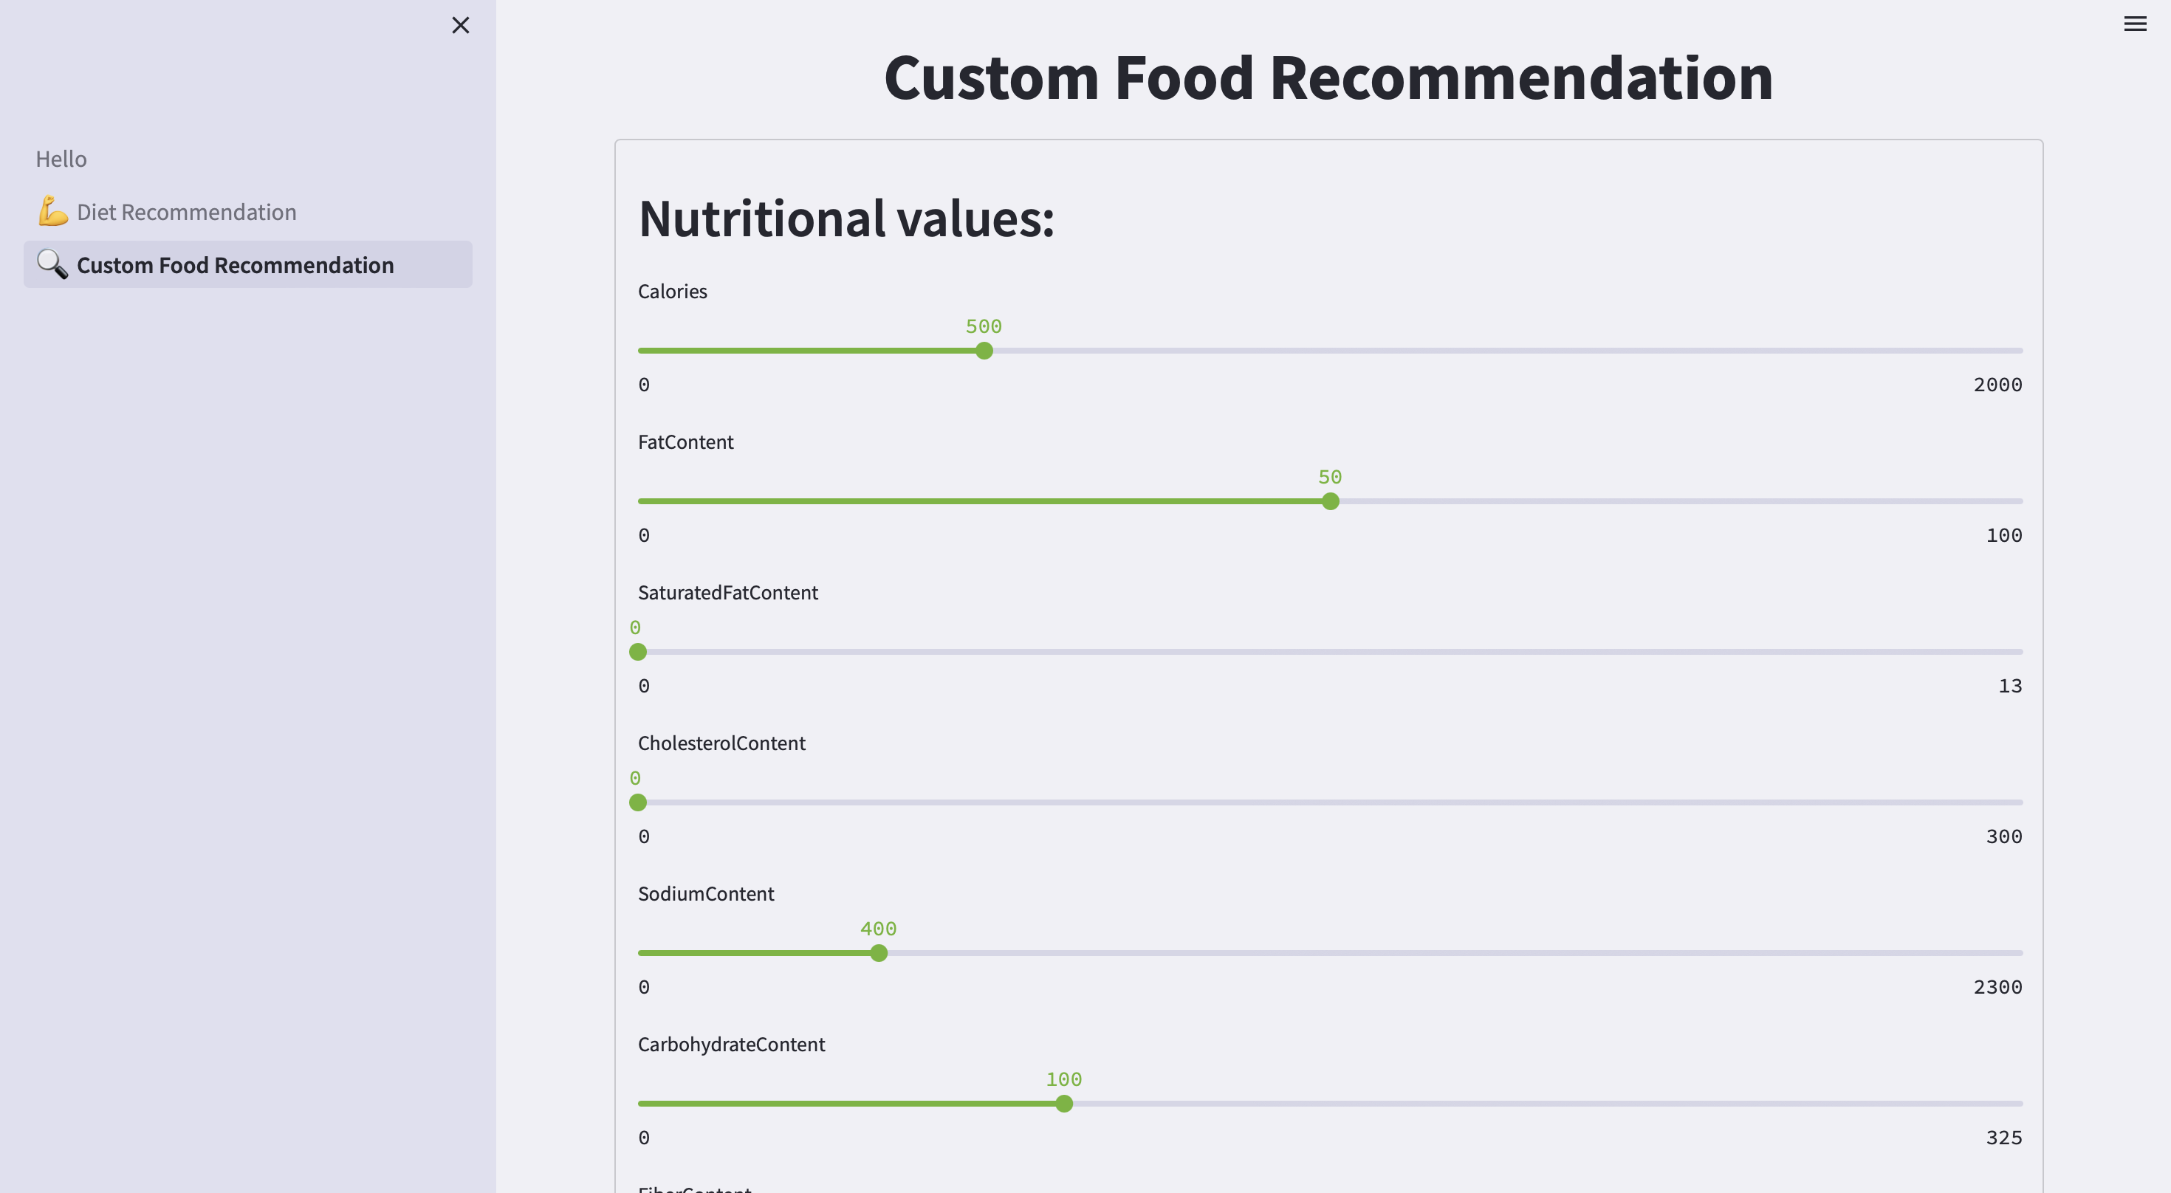

Slide 19
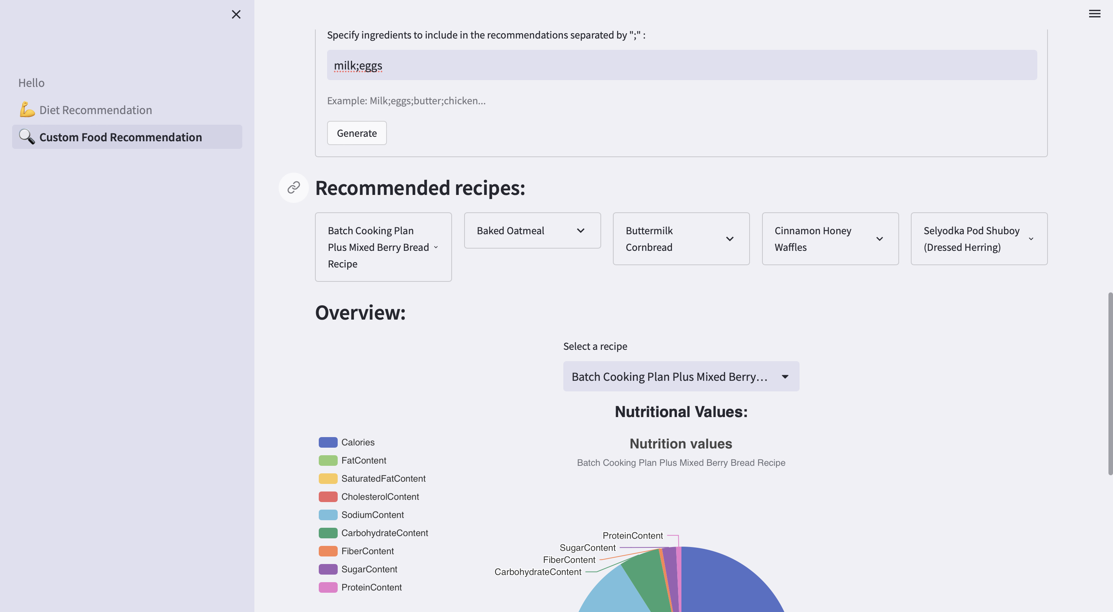

Slide 20
10. References
N. Jain, A. K. Sharma, and N. Khare, "Comprehensive Study of Routing Protocols in Mobile Ad Hoc Networks," 2020 Second International Conference on Inventive Research in Computing Applications (ICIRCA), Coimbatore, India, 2020, pp. 635-640, doi: 10.1109/ICIRCA49882.2020.10074213.
S. Kumar, R. Chauhan and N. Kumar, "Survey and Comparative Analysis of Energy Efficient MAC Protocols for WSN," 2020 International Conference on Smart Electronics and Communication (ICOSEC), Trichy, India, 2020, pp. 647-651, doi: 10.1109/ICOSEC49091.2020.9195622.
S. Raza, M. Akbar, M. Akhtar, M. Ismail, and M. J. Gondal, "Energy-Efficient Routing Protocols in Wireless Sensor Networks: A Survey," 2021 IEEE Access, vol. 9, pp. 29526-29548, 2021, doi: 10.1109/ACCESS.2021.3066002.
P. Lal, R. Kumar and R. Kumar, "A Comprehensive Study and Comparative Analysis of QoS in Ad Hoc Networks," 2017 9th International Conference on Computational Intelligence and Communication Networks (CICN), Gwalior, India, 2017, pp. 188-192, doi: 10.1109/CICN.2017.8260796.
K. Agrawal, G. B. Singha and A. K. Luhach, "A Comprehensive Survey of Mobile Agent Migration in WSNs," 2012 Ninth International Symposium on Pervasive Systems, Algorithms and Networks, San Marcos, TX, USA, 2012, pp. 118-123, doi: 10.1109/I-SPAN.2012.6265373.
A. S. Pillai, V. Wagh and R. H. Goudar, "Survey of Routing Protocols in Mobile Adhoc Network," 2009 International Conference on Computer and Communication Technology, Allahabad, India, 2009, pp. 96-100, doi: 10.1109/ICCCT.2009.5192325.

Slide 21
THANK YOU!

